Slide 1
housing costs
Madhukar Mantravadi

Slide 2
Intro to market
Models so far
What’s next
Conclusions

Slide 3
Introduction

Slide 4
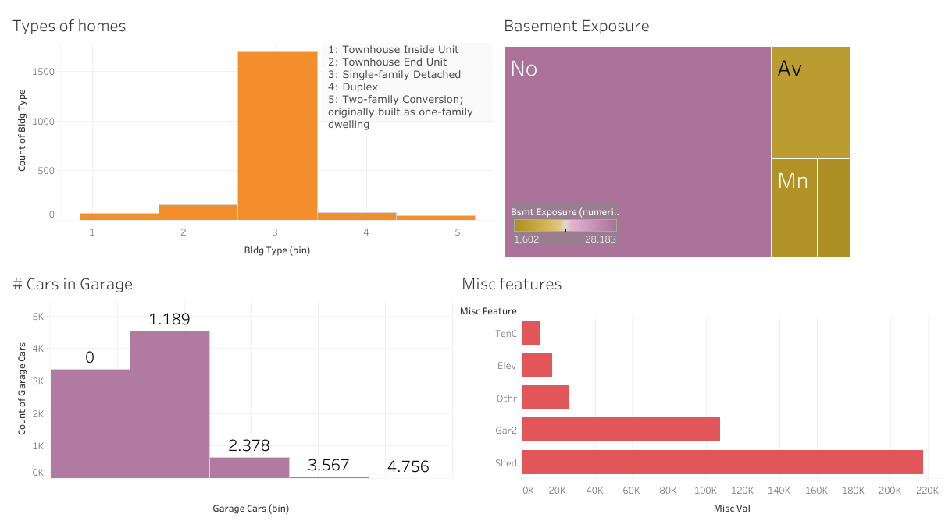
What is housing like in ames?

Slide 5
Models

Slide 6
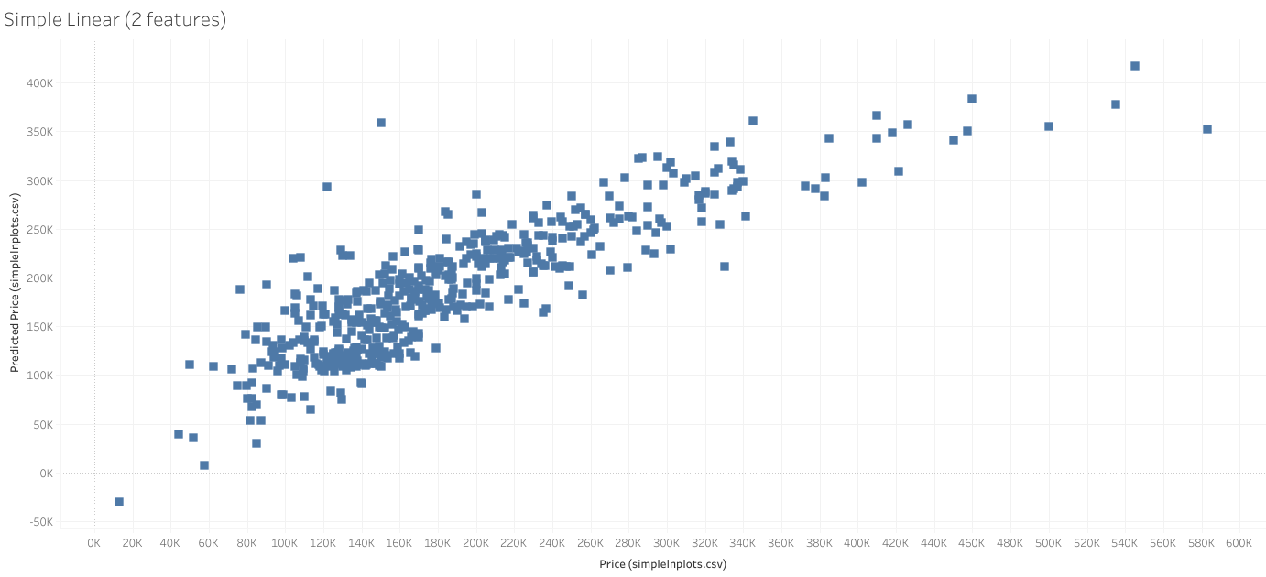

Slide 7
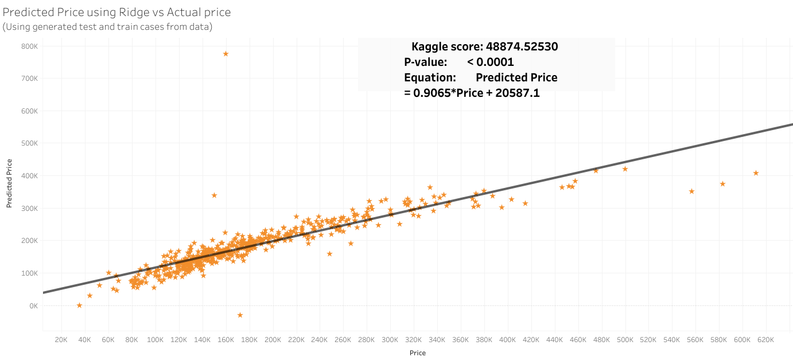

Slide 8
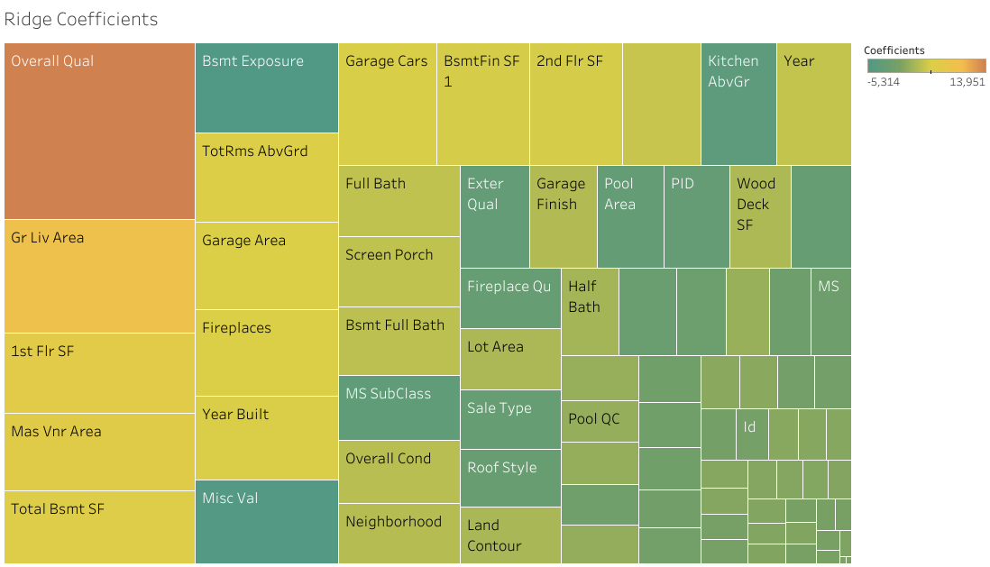

Slide 9
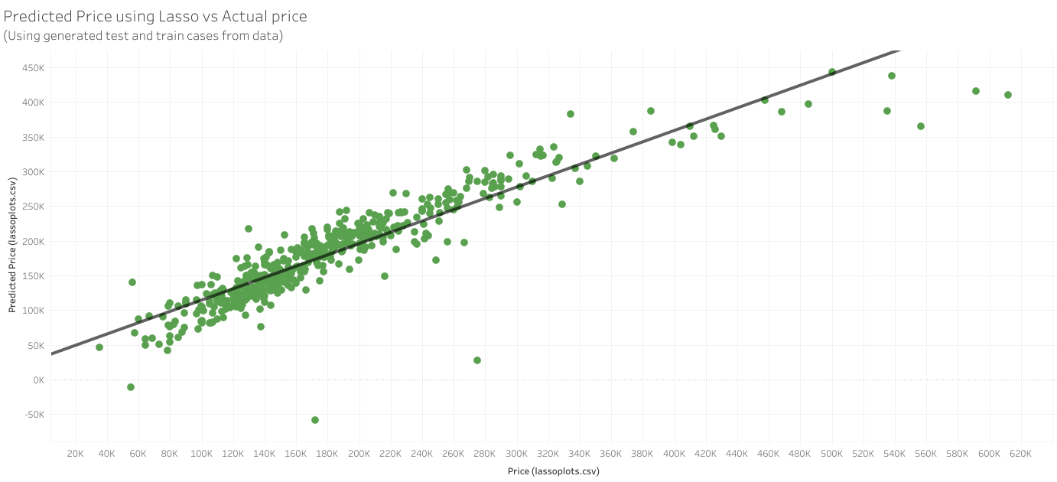

Slide 10
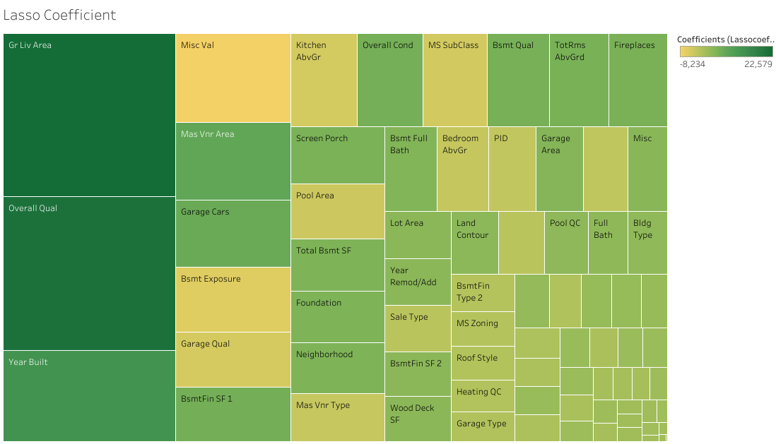

Slide 11
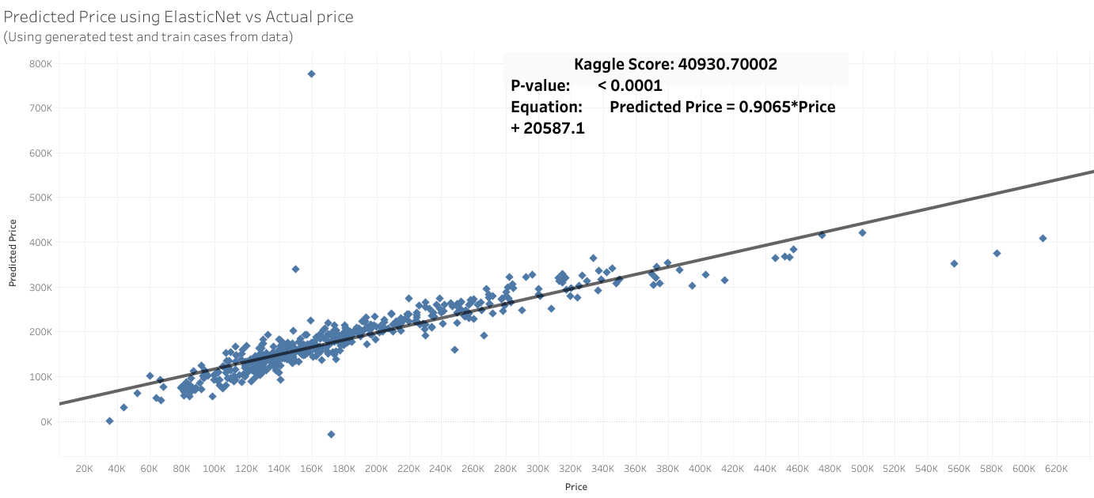

Slide 12
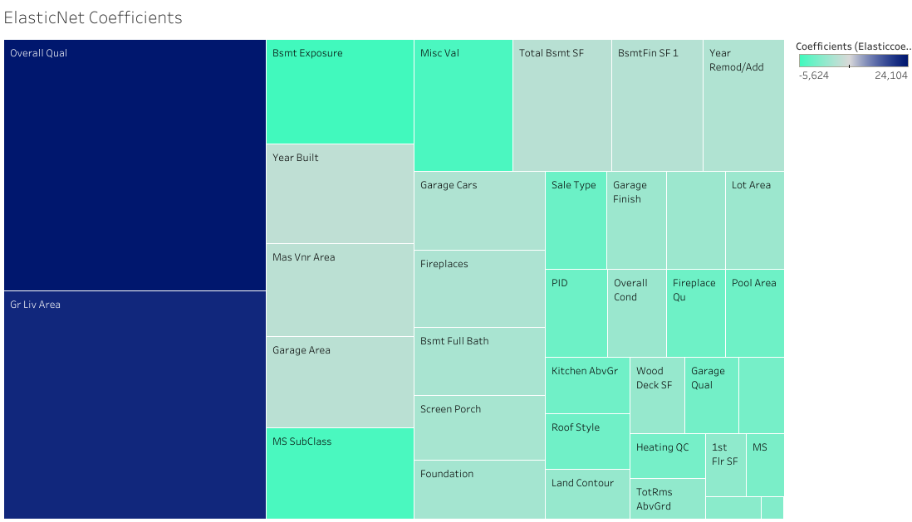

Slide 13
What’s Next

Slide 17
Conclusions

Slide 18
Questions?

